Slide 1
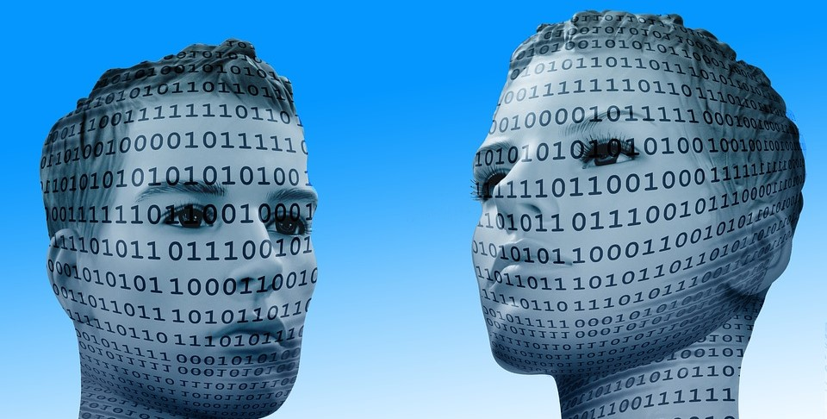
Face RECOGNITION
Using raspberry PI, opencv and deep learning

Slide 2
GOALS
To develop a face recognition system which could help in some practical applications like Security, Immigration, Banking, Mobile unlocking and Verification.
System Specifications: Azure Cloud Platform - NVIDIA Tesla K80 with 1 GPU and 12 GPU memory GiB, Google Colab is also used.
Raspberry Pi: Model B, Pi camera

Slide 3
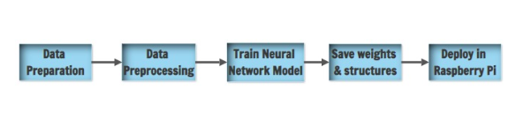
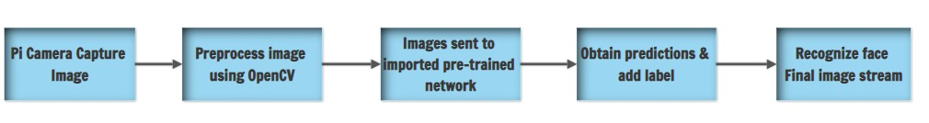
Pipeline Design

Slide 4

Data preparation
Data Preparation is performed manually:
Realtime videos are converted to image frame’s
Bing API from Azure Cognitive services is used to fetch images of different people

Slide 5

Data pre-processing
Resized dataset to 150x150 dimensions using Bilinear Algorithm
Split the data into train and validation sets with 80-20 ratio to maintain structure for building model

Slide 6
MODEL ANALYSIS
BEST MODEL ARCHITECTURE:
Number of layers: 9
Optimizer used: adam
Number of epochs: 70
Activation function used: Relu
Regularization used: Dropout, Batch normalization, Customized layer to add regularization to dense layers

Slide 7
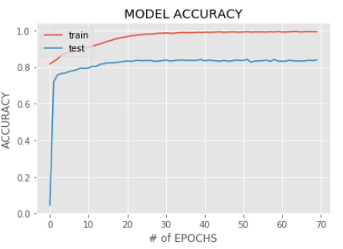
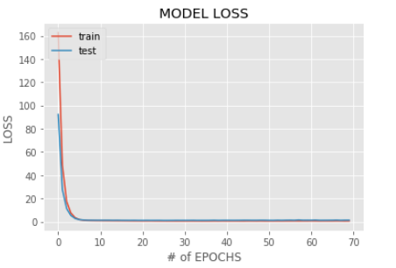
MODEL PERFORMANCE

Slide 8
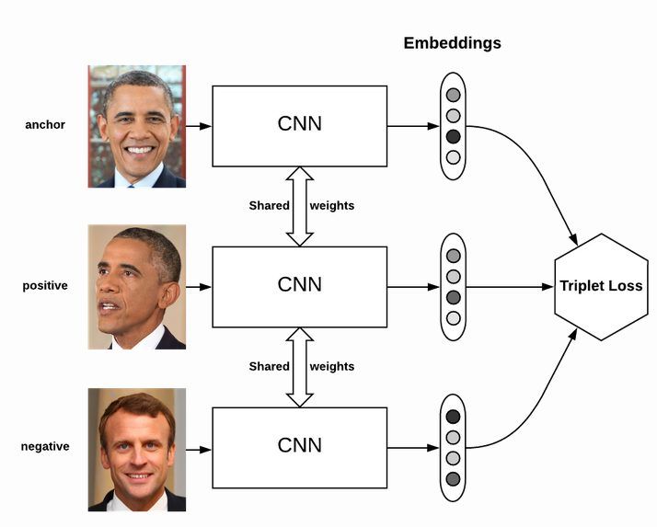
One Shot Learning
One-shot learning aims to learn information about face features from one, or only a few, training samples/ images.
To implement the same, we used Face Net Architecture and its pre-trained weights.
Facenet architecture uses concept of Triplet Loss and Siamese Network.

Slide 9
DEPLOYMEnt
DEPLOYMENT OF MODEL BUILT FROM SCRATCH IN RASPBERRY PI
Saved model weights and serialized structure are deployed in Pi
Configuration of camera module and other dependencies to run model is performed in Pi
Sample Demo:
https://www.youtube.com/watch?v=EDhBUizuO6s&feature=youtu.be
FOR ONE SHOT LEARNING
Implementation is done in local machine using its camera

Slide 10
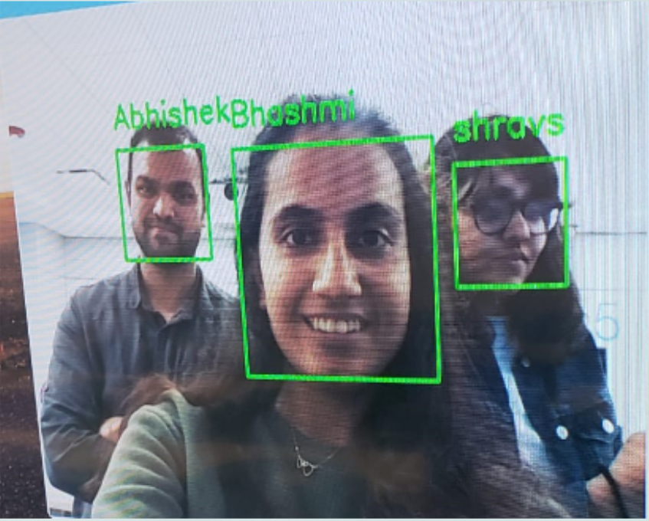
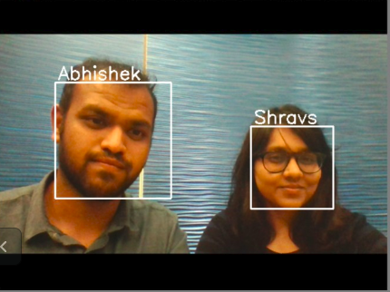
Sample output frames captured during demo

Slide 11

questions

